Slide 1
Measurement
Rule up 3 column notes!
Topic: Area Revision
EQ: How do we convert area units and find the area of shapes?
Mrs Stretch
Year 9

Slide 2
What is Area?
Area measures the surface of something
1 metre
1 cm
1 mm
1 metre
1 m²
1 mm
1 mm²
1 cm
1 cm²
1 square metre

Slide 3

24
7
30
Area Revision
Date
EQ – How do we convert area units and find the area of shapes?
Examples
Steps
Converting Units of Length
To make a unit bigger you DIVIDE
To make a unit smaller you MULTIPLY
1. 46 km to m
2. 500 mm to cm
3. 830 cm to km

Slide 4
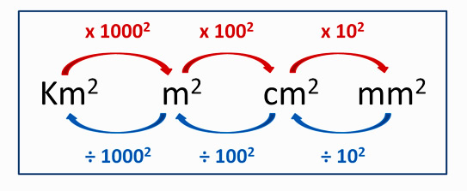
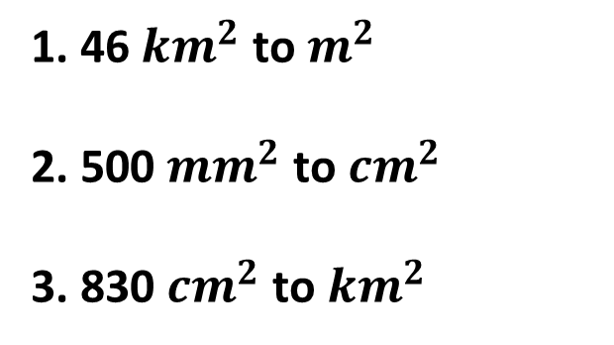
24
7
30
Area Revision
Date
EQ – How do we convert area units and find the area of shapes?
Examples
Steps
Converting Area Units
To make a unit bigger you DIVIDE
To make a unit smaller you MULTIPLY
1. 46 ${km}^{2}$ to $m^{2}$
2. 500 ${mm}^{2}$ to ${cm}^{2}$
3. 830 ${cm}^{2}$ to ${km}^{2}$

Slide 5
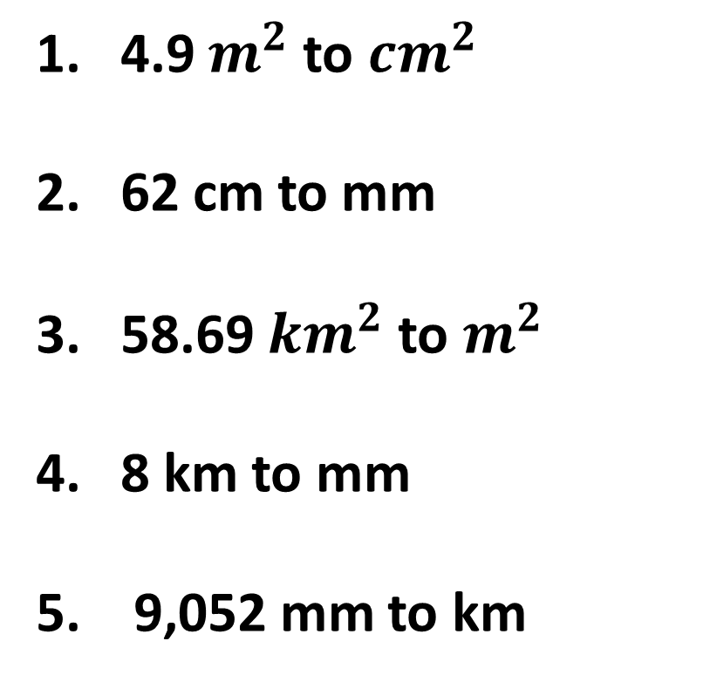
Practice
1. 4.9 $m^{2}$ to ${cm}^{2}$
2. 62 cm to mm
3. 58.69 ${km}^{2}$ to $m^{2}$
4. 8 km to mm
5. 9,052 mm to km

Slide 6


Slide 7
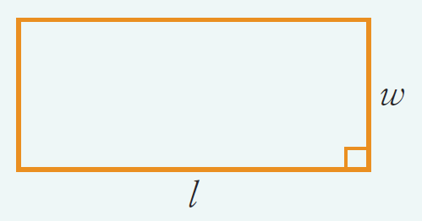
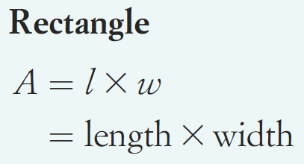
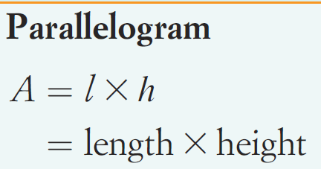
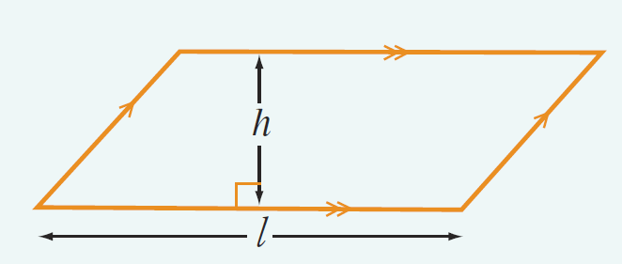
24
7
30
Area Revision
Date
EQ – How do we convert area units and find the area of shapes?
Examples
Steps
How do we find the area of 2 dimensional shapes?
Rectangle
Parallelogram

Slide 8
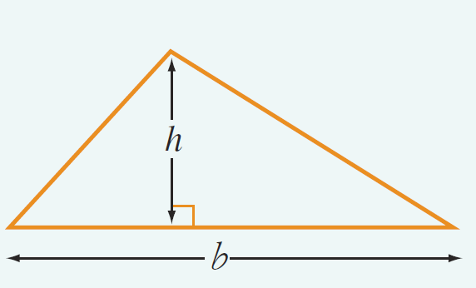
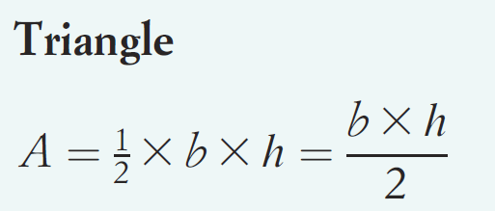
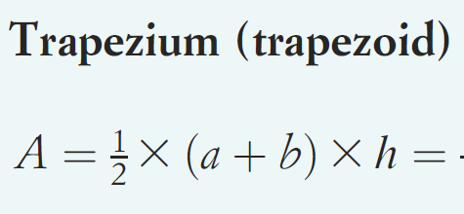
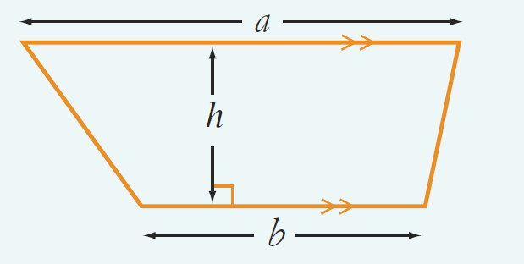
24
7
30
Area Revision
Date
EQ – How do we convert area units and find the area of shapes?
Examples
Steps
How do we find the area of 2 dimensional shapes?
Triangle
Trapezium

Slide 9
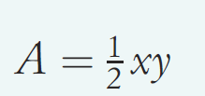
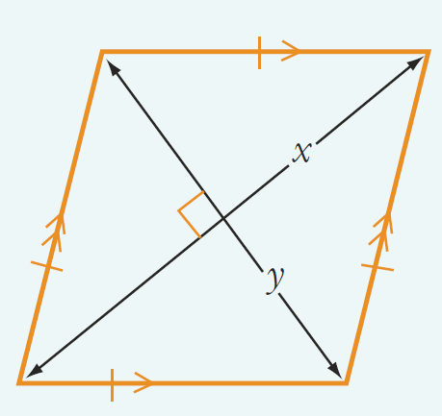
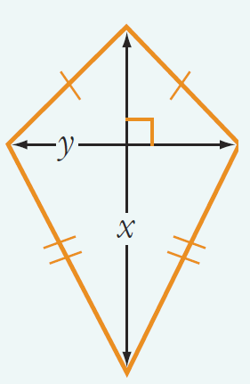
24
7
30
Area Revision
Date
EQ – How do we convert area units and find the area of shapes?
Examples
Steps
How do we find the area of 2 dimensional shapes?
Rhombus
Kite

Slide 10
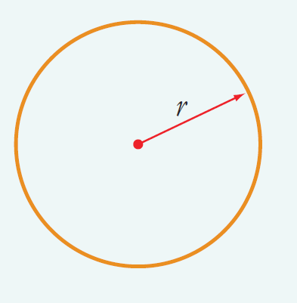
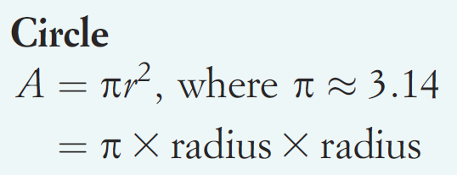
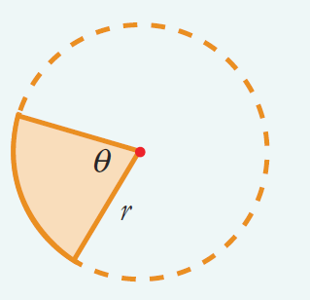
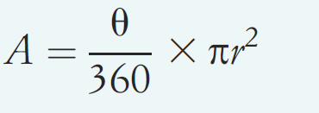
24
7
30
Area Revision
Date
EQ – How do we convert area units and find the area of shapes?
Examples
Steps
How do we find the area of 2 dimensional shapes?
Circle
Sector of a Sector
Sector of a Sector

Slide 12
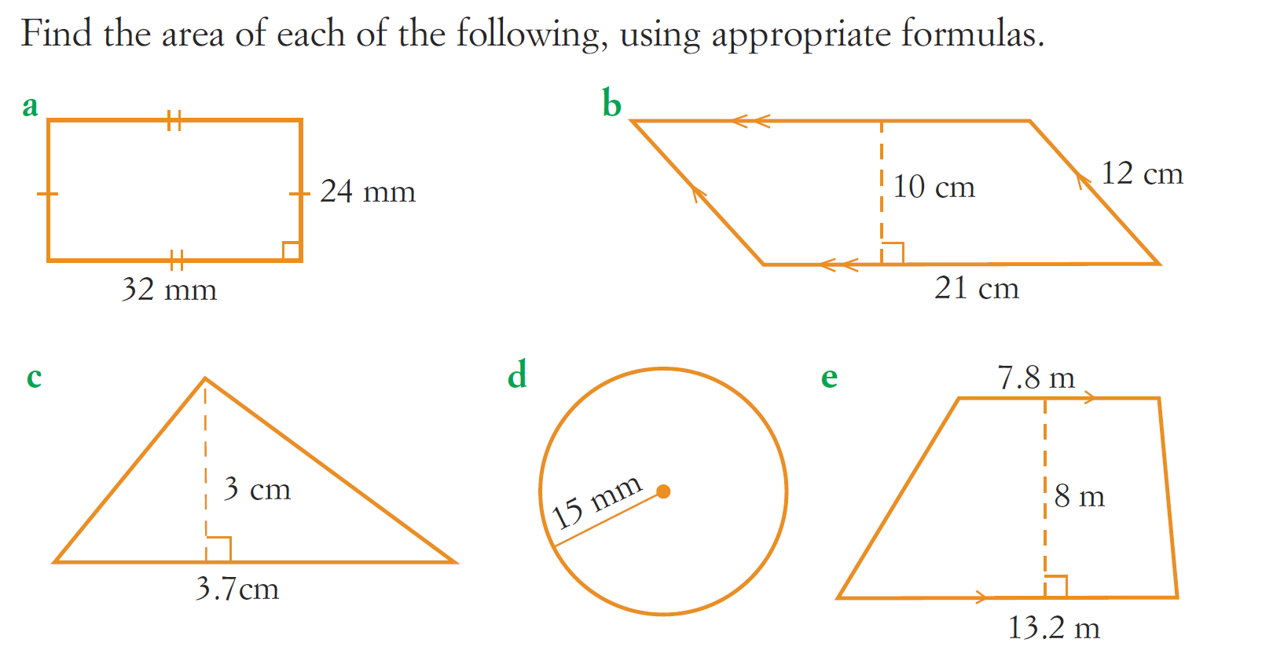
Practice

Slide 13
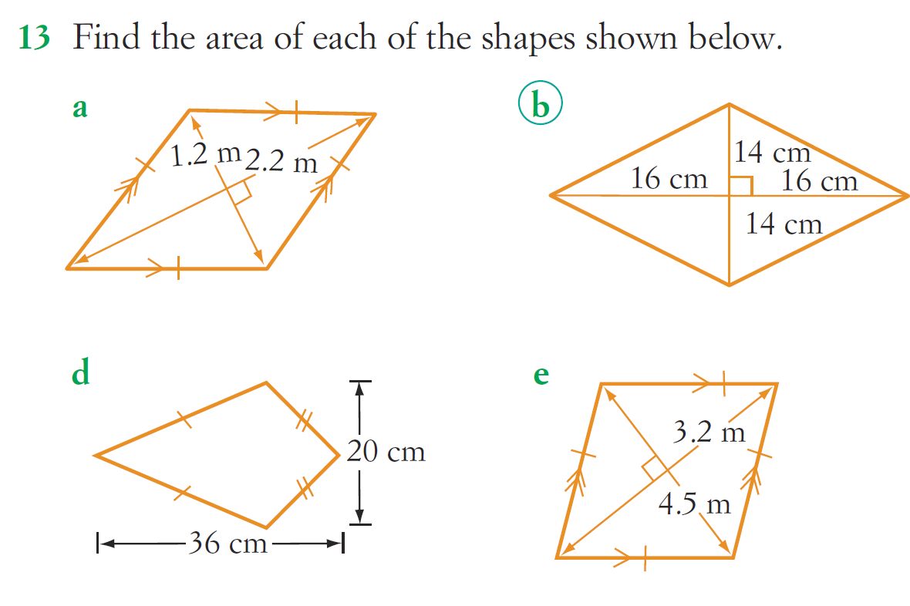
Task

